Slide 1
VMware {code} Experience Training
Open Source Projects for Enterprise Cloud Native
Ben Corrie, Senior Staff Engineer
Henry Zhang, Chief Architect, R&D, VMware China
Patrick Daigle, Sr. Tech Marketing Architect, VIC Steven Zou, Staff Engineer, Project Harbor

Slide 2
Disclaimer
This presentation may contain product features that are currently under development.
This overview of new technology represents no commitment from VMware to deliver these features in any generally available product.
Features are subject to change, and must not be included in contracts, purchase orders, or sales agreements of any kind.
Technical feasibility and market demand will affect final delivery.
Pricing and packaging for any new technologies or features discussed or presented have not been determined.
2

Slide 3
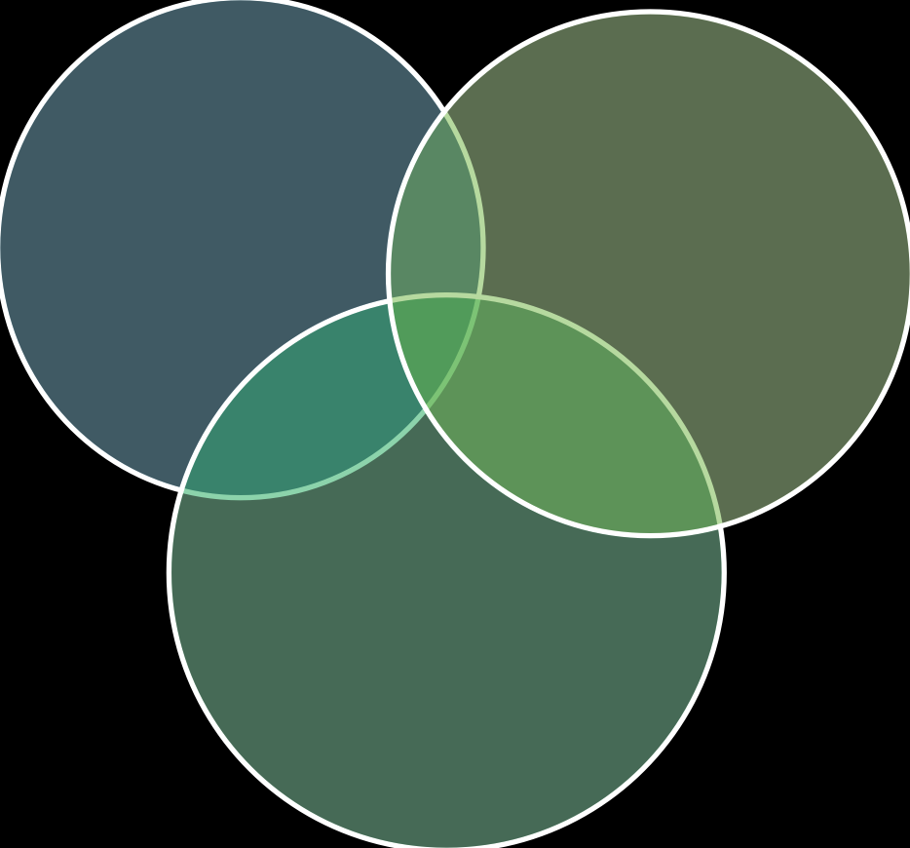
VMware’s Participation in Open Source Community
Contribute to upstream projects to add features or fix bugs:
Use open source code within the enterprise:
Linux kernel drivers for our virtual hardware, but also work on key kernel infrastructure
Open Stack improvement for network, storage, stability
Kubernetes integration with vSphere as compute and storage provider
Many smaller contributions and bug fixes to a wide variety of projects
For implementation of industry standards
To improve software usability
To accelerate our software development processes
Use
Contribute
Create
Create and release a new open source project and build new community to support it
Variety of project – from utilities and glue code to significant, standard-setting projects
3

Slide 4

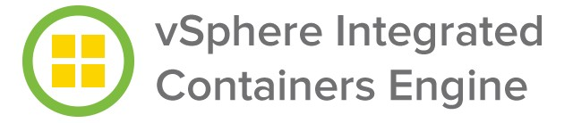

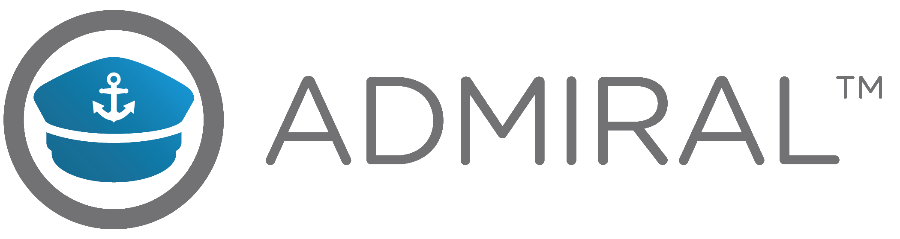



Leadership in Open Source Cloud Native Projects
4

Slide 5
vSphere Integrated Containers

Slide 6
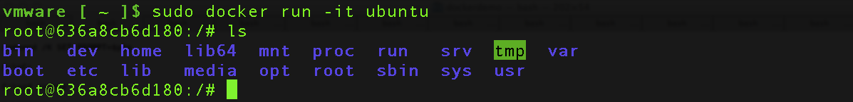























Docker 101
LINUX HOST
Docker Client
Docker Hub
S D N
LXC
Container
Control & TTY
/ COM0
Pull Image
Control & TTY
/ REST
Docker Daemon
Mount Image
Container
NET TRAFFIC TO CONTAINERS
Docker Images
Layered file system (AUFS)
Container

Slide 7


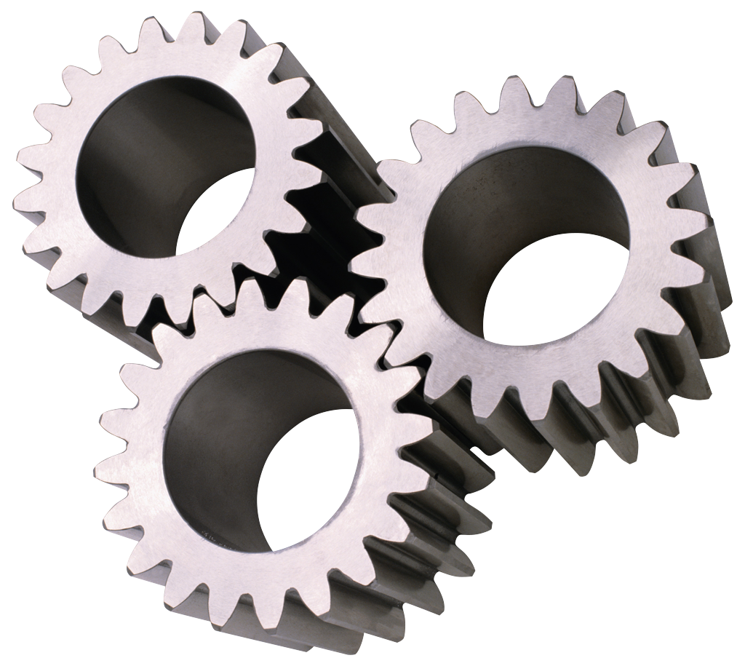



What is a Container?
An executable process
Resource constraints / private namespace
Binary dependencies: Application, runtime, OS
A shared Linux kernel for running the executable
Ephemeral and persistent storage layers
LINUX HOST
STATELESS PORTABLE FAST SECURE
Docker Client
S D N
Container
Docker Hub
Docker Daemon
Pull Image
Control & TTY
/ REST
NET TRAFFIC TO CONTAINERS
Docker Images
Layered file system (AUFS)
Linux Kernel

Slide 8

What is a Container Host?
Control plane & lifecycle management for containers
Resource scheduling and a container abstraction
Infrastructure abstractions: Storage, networking etc
A single Linux kernel manages everything
A static size and a resource reservation when virtual
LINUX HOST
STATEFUL LONG-RUNNING SINGLE USER SINGLE USE
Docker Client
S D N
LXC
Container
Docker Hub
Docker Daemon
Pull Image
Control & TTY
/ REST
Container
NET TRAFFIC TO CONTAINERS
Docker Images
Layered file system (AUFS)
Container
Linux Kernel

Slide 9



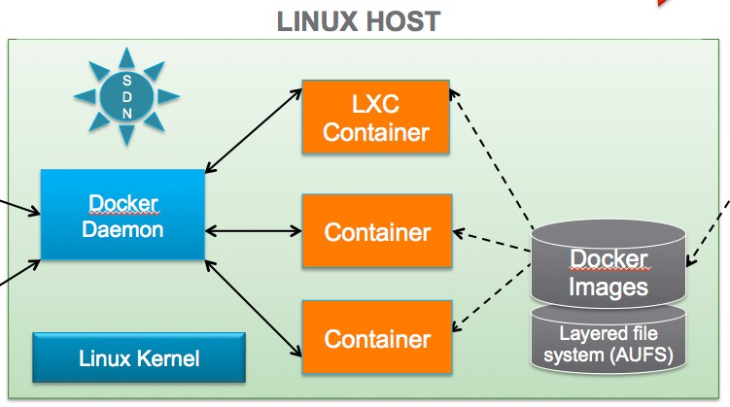

What is a Hypervisor?
Control plane & lifecycle management for VMs
Resource scheduling and a VM abstraction
Infrastructure abstractions: Storage, networking etc
A hypervisor kernel manages everything except apps
A static size, but no resource concerns unless nested
ESX HOST
STATEFUL LONG-RUNNING MULTI USER MULTI USE
vSphere Client
S D N
VM
Linux
MyVMware
vCenter
Pull Image
SOAP / XML
HTTP
VM
Windows
VMDKs
ESX Kernel
VMFS / vSAN

Slide 10
Types of Containers
Long-running
Can be stateless or stateful
Eg. Application servers, databases, load-balancers, KV stores etc
Typically a need for strong isolation
Transactional
Runs for a period and transforms some data
Eg. Runs a build. Processes a web request. Batch processing
Should only consume resource when running
Sidecar / helpers
Augments the capabilities of a service or provides a helper function
Eg. Logging, monitoring, caching
Scales with the service. Potentially hindered by strong isolation

Slide 11
Isolation Domains and Data Persistence
How do I isolate workloads from each other?
Runtime isolation – resource limits, kernel panic, ESX host failure, rack or region failure
Network isolation – traffic sniffing, firewalls, encryption, rate limiting
Storage isolation – data persistence, backup, networking, RBAC
Stateful vs Stateless / Cattle vs Pets
Different classifications of data. Where should it go?
Image state, container state, volume state. What’s the difference?
Should data lifespan be inherently tied to compute (VM / container)?
Without live migration, shared storage and HA, stateless looks attractive
The question is not “what plumbing do I need?”
What characteristics or business value do I need for my application?
Better question than, “do I need a container or a VM?”

Slide 12
Characteristics: Containers vs VMs? So 2014!
Speed
Start time vs throughput. Benefits transactional containers
Hello World vs Tomcat. Less benefit for long-running apps
Efficiency
Less memory consumption? Depends when virtualized
Network traffic NAT’d through guest vs straight to vNIC
Portability
Docker image abstraction and API is very portable
Subtle issues with kernel versions and patches
Isolation
Shared kernel significantly reduces runtime isolation
Granularity
- Containers are great for granular services. Group in a VM as isolation domain.

Slide 13
Container Workflow Efficiencies
A Portable Runtime Platform
“Package once, run anywhere”
Defacto runtime model for higher level frameworks
The Container Model
“Docker is to apt what apt is to tar” – dependency management
Snapshotting, image format, Docker Hub, state management (volumes etc)
Scripting and automation – express an environment in a text file
Predictable initialization state – predictability vs. reconfiguration
Continuous Integration
Secure registries, integration with popular tooling
Rapid improvements in tooling, monitoring, log integration etc.

Slide 14
The Container Stack and Its Challenges
I want to run containers. Where do I start?
Should I run containers alongside my other apps or create a silo?
Should I be considering bare metal?
So how many containers should I have in each VM?
How big should each container host be? Impact of re-configuration?
Which containers can be safely co-located with which other containers?
Which Linux distro do I want and how to handle the high patch cadence?
Who is responsible for infrastructure admin and how does it integrate?

Slide 15
So What is VIC and How does it help?
VIC brings all of the container workflow efficiencies to vSphere infrastructure
Control vSphere infrastructure from a Docker client without having any vSphere credentials
Treat VMs as ephemerally as containers
No more OVAs, VMDKs, Templates, Cloning. Push / pull your state from secure registries
VIC allows you to translate business value into plumbing
Eg. I need to deploy Wordpress with MySQL.
Do I want strong isolation between these workloads? Container as a VM
Do I want strong isolation from other tenants? Container in a VM
VIC helps to draw clear lines between admins and users

Slide 16
Revisit: What is a Container Host?
Control plane & lifecycle management for containers
Resource scheduling and a container abstraction
Infrastructure abstractions: Storage, networking etc
A single Linux kernel manages everything
A static size and a resource reservation when virtual
LINUX HOST
STATEFUL LONG-RUNNING SINGLE USER SINGLE USE
Docker Client
S D N
LXC
Container
Docker Hub
Docker Daemon
Pull Image
Control & TTY
/ REST
Container
NET TRAFFIC TO CONTAINERS
Docker Images
Layered file system (AUFS)
Container
Linux Kernel

Slide 17







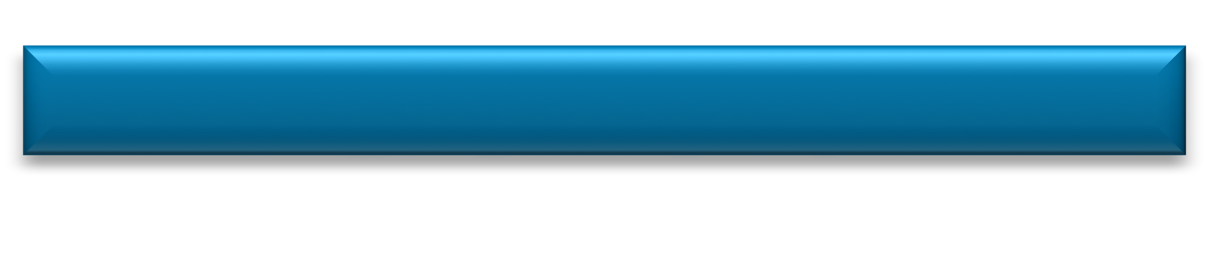

What is a “ContainerVM”?
An executable process
Resource constraints / private namespace
Binary dependencies: Application, runtime, OS
A private Linux kernel for running the executable
Ephemeral and persistent storage layers
ESX HOST / HYPERVISOR
STATELESS PORTABLE FAST SECURE
Docker Client
S D N
ContainerVM
Docker Hub
Docker Daemon VM
Pull Image
Control & TTY
/ REST
NET TRAFFIC TO CONTAINERS
Docker Images
Layered file system (VMFS)
vCenter
Linux Kernel
ESX Kernel

Slide 18
















What is a Virtual Container Host?
Control plane & lifecycle management for ContainerVMs
Resource scheduling and a container abstraction
Infrastructure abstractions: Storage, networking etc
A Linux kernel per container, separate from control plane
Dynamic size and a resource limit, not reservation!
vSphere Cluster
ESX Host ESX Host
VIRTUAL SINGLE USER MULTI USE MULTI HOST
Docker Hub
Pull Image
ESX Host
Docker Client
S D N
Docker Daemon
ContainerVM
VCH 1
ContainerVM
Docker Daemon
VCH 2
NET TRAFFIC TO CONTAINERS
Docker Images
Layered file system (VMFS)
vCenter

Slide 19
VIC Roadmap
VIC 1.0
Docker engine and registry (Harbor) shipped in Q4 2016
MVP Docker commands. Fundamentals of integration
vSAN, vMotion, DRS, NSX distributed port groups
VIC 1.1
Additional Docker capabilities – Eg. compose, exec
Critical bug fixes
Deeper SDDC integrations – Eg. HA
VIC 1.2
Security enhancements – Image signing, vulnerability scanning
Additional Docker capabilities
Deeper NSX integration
Further SDDC integrations – vVols, SDRS

Slide 20
Questions
@bensdoings Github.com/vmware/vic-product

Slide 21
Demo - VIC

Slide 22


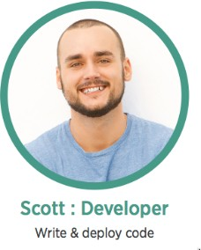
New in 1.2 - Developer Sandbox
Developer self-service with VI Admin governance
Developer consumes resources via Docker API/CLI
Provides developers with self-service for applications not yet in the enterprise service catalog
Rapid prototyping
Run a full-fledged docker engine as a ContainerVM using vSphere Integrated Containers and the Docker API/CLI
Docker Container Host
C
C
C
Docker Engine
Linux Kernel
VIC Engine
docker run –p 12375:2375 –d vmware/dch-photon

Slide 23
Project Harbor

Slide 24
Harbor
 | 1 | Container Image Basics
 | 2 | Project Harbor Introduction
 | 3 | Consistency of Images
 | 4 | Security
 | 5 | Image Distribution

Slide 25









Lifecycle of Containers and Images
Registry
Images
Push
tag
Pull
Dockerfile
Build
Images
Save
tar archive
Load
Commit
Run
Containers
Stop Start Restart

Slide 26



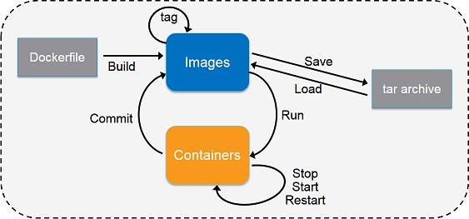
Registry - Key Component to Manage Images
Repository for storing images
Intermediary for shipping and distributing images
Ideal for access control and other image management
Registry
Images
Push
Pull

Slide 27
Harbor
 | 1 | Container Image Basics
 | 2 | Project Harbor Introduction
 | 3 | Consistency of Images
 | 4 | Security
 | 5 | Image Distribution
 | 6 | High Availability of Registry

Slide 28
Project Harbor
An open source enterprise-class registry server.
Initiated by VMware China, adopted by users worldwide.
Integrated into vSphere Integrated Containers.
Apache 2 license.
https://github.com/vmware/harbor/

Slide 29

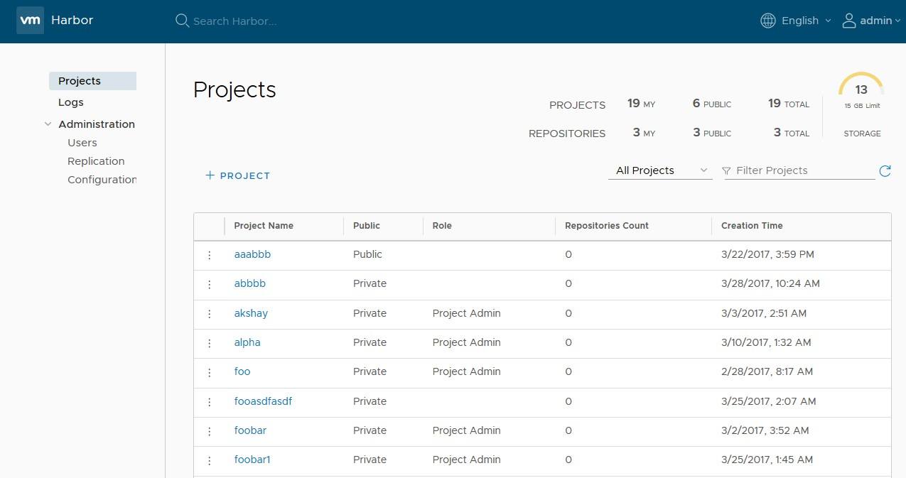
Key Features
User management & access control
RBAC: admin, developer, guest
AD/LDAP integration
Policy based image replication
Notary
Vulnerability Scanning
Web UI
Audit and logs
Restful API for integration
Lightweight and easy deployment

Slide 30














Users and Developers
Users
20K+
2600+
300+
Downloads
Developers
Stars
Users
700+
55
6
Forks
Contributors
Partners

Slide 31







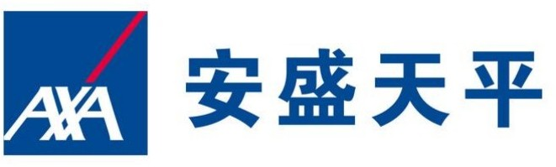










Harbor users and partners

Slide 32


















































Harbor Architecture
Harbor
Notary client
Notary
Remote Harbor Instance
Registry V2
Replication Job Services
Docker client
Nginx
UI
Vulnerability Scanning
Core Service
Browser
API
Auth
Admin Service
AD / LDAP
Log Collector
DB

Slide 33











Image replication (synchronization)
Project
Project
Policy
Images
Images
Initial replication
Image
Image
incremental replication (including image deletion)
33

Slide 34
Harbor
 | 1 | Container Image Basics
 | 2 | Project Harbor Introduction
 | 3 | Consistency of Images
 | 4 | Security
 | 5 | Image Distribution

Slide 35
Consistency of Container Images
Container images are used throughout the life cycle of software development
Dev
Test
Staging
Production
Consistency must be maintained
Version control
Issue tracking
Troubleshooting
Auditing

Slide 36
Same Dockerfile Always Builds Same Image?
Example:
FROM ubuntu
RUN apt-get install –y python ADD app.jar /myapp/app.jar
Base image ubuntu:latest could be changed between builds
ubuntu:14.04 could also be changed due to patching
apt-get (curl, wget..) cannot guarantee always to install the same packages
ADD depends on the build time environment to add files

Slide 37











Shipping Images in Binary Format for Consistency
Git
ima.es ima.es
ima.es
I
Test Re.istry
Dev Re.istry
ima.es
ima.es
ima.es
Sta.in. Re.istry
Production Re.istry
Ima.es are synchronized between environments by usin. Harbor re.istry.
37

Slide 38
Harbbor
1
Container Image Basics
2
Project Harbor Introduction
3
Consistency of Images
4
Security
5
Image Distribution

Slide 39
Access Control to Images
Organizations often keep images within their own organizations
Intellectual property stays in organization
Efficiency: LAN vs WAN
People with different roles should have different access
Developer – Read/Write
Tester – Read Only
Different rules should be enforced in different environments
Dev/test env – many people can access
Production – a limited number of people can access
Can be integrated with internal user management system
LDAP/Active Directory

Slide 40




Example: Role Based Access Control in Harbor
Project
Members
Images
Guest:
docker pull ...
${Project}/ubuntu:14.04
${Project}/nginx:1.8, 1.9
${Project}/golang:1.6.2
${Project}/redis:3.0
Developer:
docker pull/push ...
…...
Admin:

Slide 41
Other security considerations
Enable content trust by installing Notary service
Image is signed by publisher’s private key during pushing
Image is pulled using digest
Perform vulnerability scanning
Identify images with vulnerabilities during pushing
Prevent images with vulnerabilities from being pulled
Regular scanning based on updated vulnerability database

Slide 42
Harbor
 | 1 | Container Image Basics
 | 2 | Project Harbor Introduction
 | 3 | Consistency of Images
 | 4 | Security
 | 5 | Image Distribution

Slide 43
Image Distribution
Container images are usually distributed from a registry.
Registry becomes the bottleneck for a large cluster of nodes
I/O
Network
Scaling out an registry server
Multiple instances of registry sharing same storage
Multiple instances of independent registry sharing no storage
43

Slide 44





















Image Distribution via Master-Slave Replication
Load balancin.
Works well with .eo.raphically distributed clients
Docker Client
push
pull
Docker host
Docker host
Docker host
Docker host
Docker host
Docker host
Master – Slave model
44

Slide 45
Demo: Harbor Registry

Slide 46
Admiral Overview

Slide 47
What is Admiral?
A lightweight Container Management Platform
Deploy and manage container based applications.
Provide placement based on dynamic policy allocation.
Container Management Layer in both vRA and VIC.
Works with VIC engine or Docker host, Harbor registry.

Slide 48

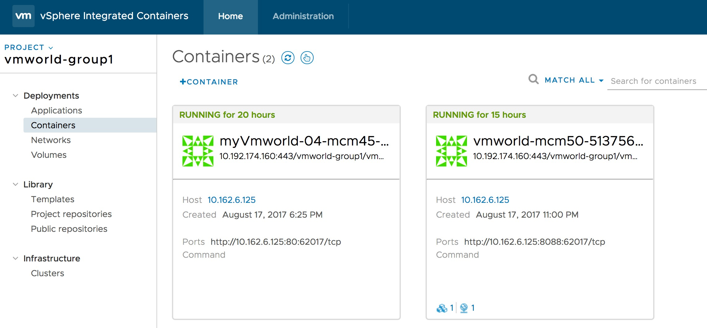

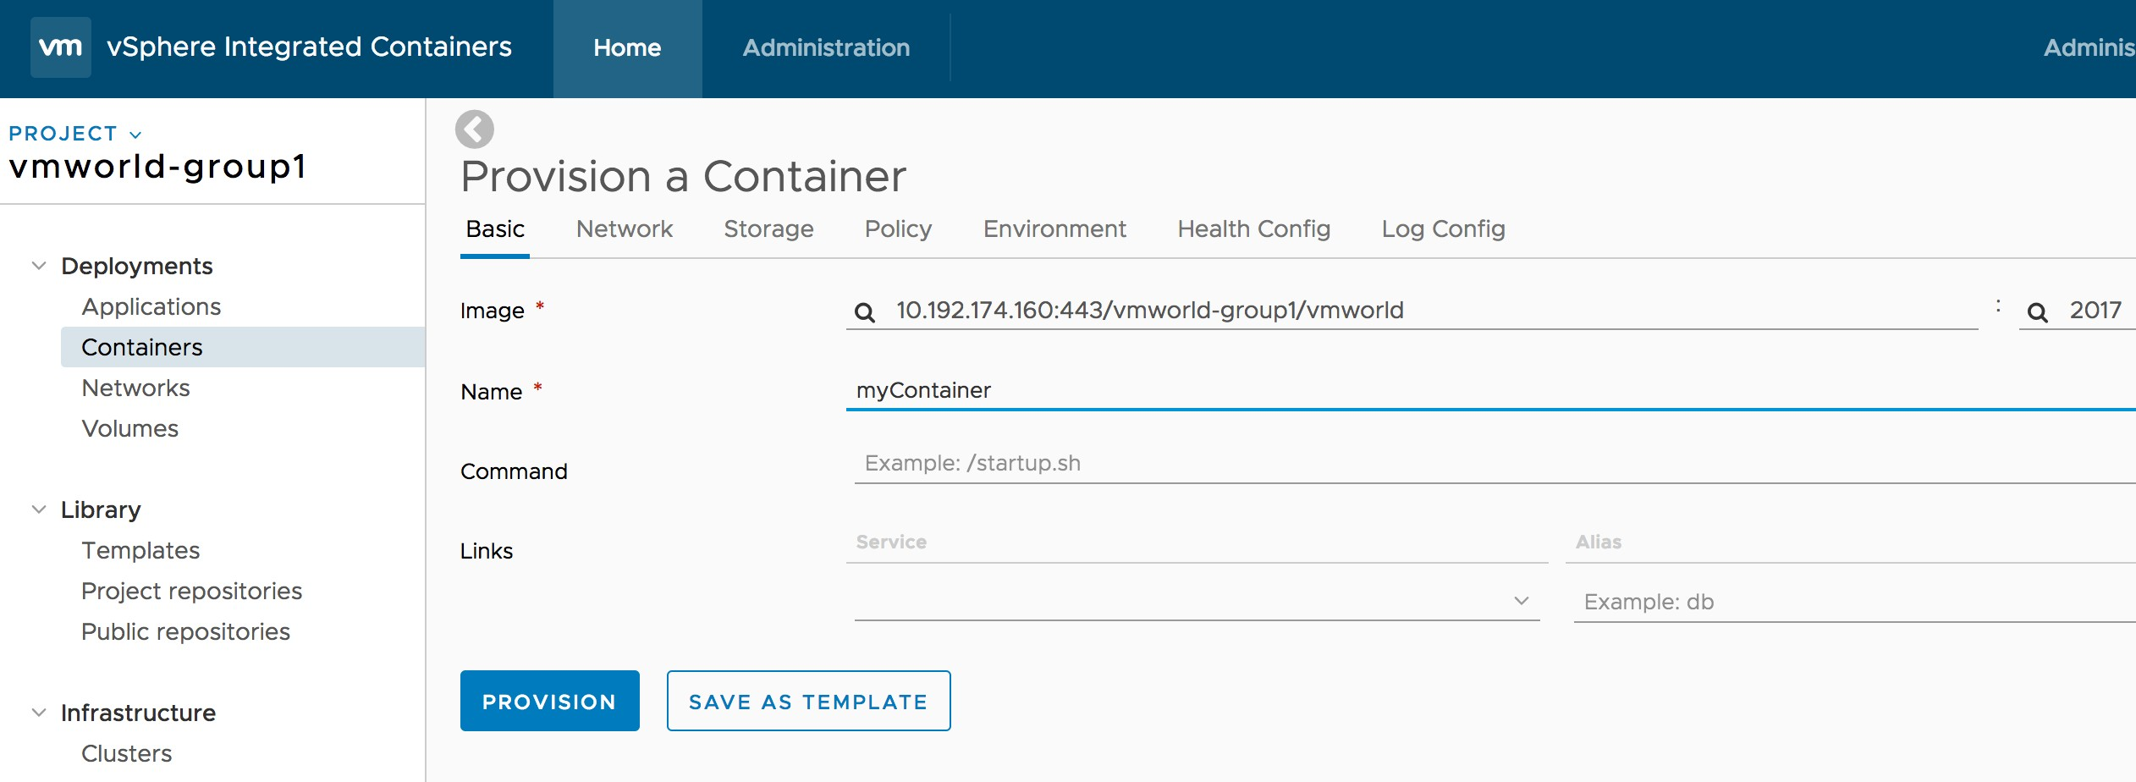
Container Deployment
Provision container with the image from the specified registry

Slide 49

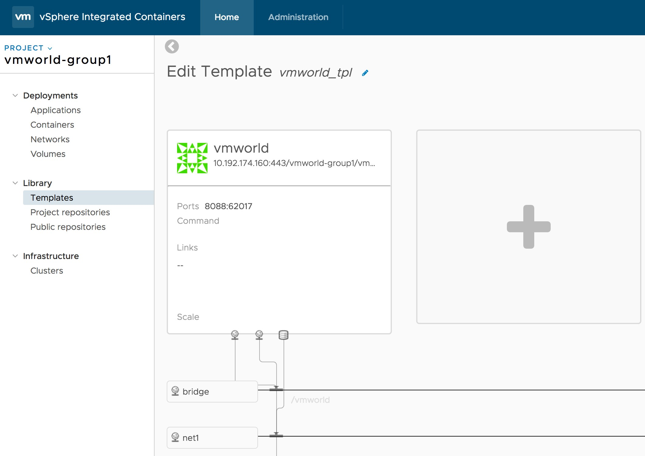
Application Template
Define your own application structure
Containers
Networks
Volumes
Provision multiple containers at one time
Compatible with docker-compose yaml file

Slide 50
Practice on VIC engine, Harbor & Admiral

Slide 51
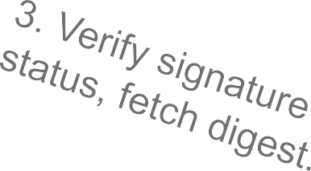


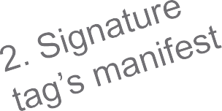










Content trust for image provenance
Notary
Image Creator
Registry
Image Consumer

Slide 52
Vulnerability Scanning
Static analysis of vulnerability by inspecting filesystem of container image and indexing features in database.
Rescanning is needed only and only if new detectors are added.
Update vulnerability data regularly
Debian Security Bug Tracker
Ubuntu CVE Tracker
Red Hat Security Data
Oracle Linux Security Data
Alpine SecDB

